Slide 1

Basic Privilege Escalation
How can we increase privileges?
Protecting and exploiting privileged access

Slide 2
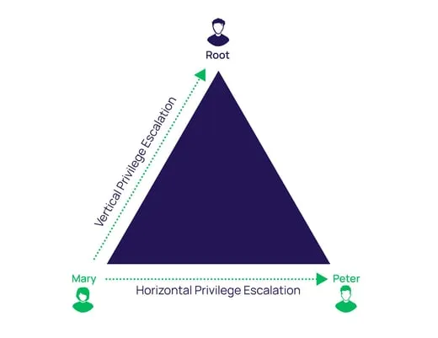
What is Privilege Escalation (Priv Esc)?
Process of gaining more permission on a system
Two main types:
  Vertical: Going from a lower privileged account to a higher one
  Horizontal: Accessing a user account with the same permission level
Assumes you already have initial access!

Slide 3
Two Scenarios
Scenario 1: Linux
Windows
Access to low privileged user
How to get user with Administrator or remote desktop access?
Potential Users:
nxc smb [ip] -u [user] -p [pass] --users
Ultimate goal NT Authority\System
Upload reverse shell
Initial access as www-data
Where do we go from here?
How do we get to root?
Potential Users:
/etc/passwd
Ultimate goal root

Slide 4
Linux: 4 Tactics
1
2
3
4
Excessive SUID Perms
Scheduled Tasks
Stolen Credentials/Keys
Excessive SUDO Perms
Passwords stored in files
Public ssh keys
Configuration file passwords
Sudo allows to run commands as root
Direct priv esc to root
Set User ID
Files can have SUID
When set file is run as owner, not the user who ran it
Referred to as Cronjobs
Periodically running tasks that if run as a high privileged user but editable can run priv esc commands

Slide 5
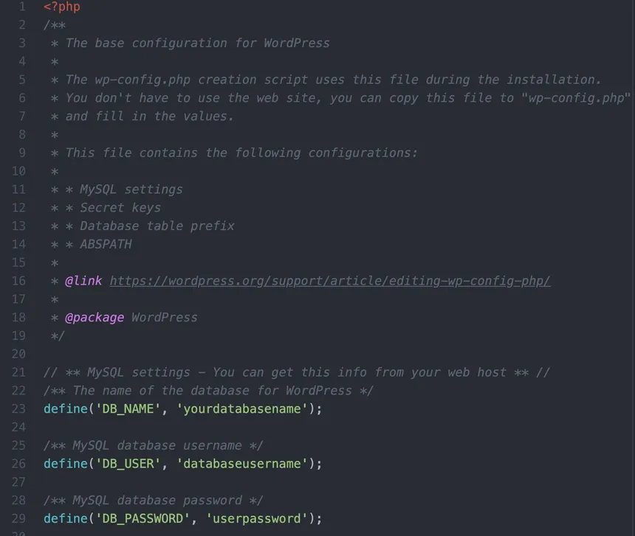
Stolen Credentials
Places to look:
~/.ssh - SSH keys
User Desktop/Documents files
Any config file
  /var/www/html/wp-config.php - Wordpress
  /etc/mysql/my.cnf
/etc/shadow
~/.bash_history
  Passwords typed into the terminal

Slide 6

GTFOBins
GTFOBins: Curated list of Unix binaries
that can be abused to GTFO of low-privilege shells
Privilege escalation
File read/write
Command execution
Shell escapes

Slide 7
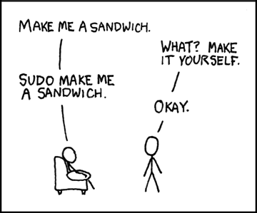
Sudo Privilege Escalation
Sudo (superuser do): Allows a user to run commands as another user, usually root.
List which commands you’re allowed to run with sudo
  Command: sudo -l
  Example: (ALL) NOPASSWD: /usr/bin/python
Check GTFOBins

Slide 8
SUID Privilege Escalation
SUID (Set User ID): When a file has SUID set, it runs as the file’s owner, not the user who launched it
If a user runs a SUID binary owned by root, we get temporary root privileges during execution
  Command: find / -perm -4000 -type f 2>/dev/null
Check GTFOBins
Note: SUID if not misconfigured is perfectly normal

Slide 9
Scheduled Task Privilege Escalation
Cron job: Scheduled task that automatically runs on a given interval
Commonly used to run scripts (backups, updates) as elevated user
  Find crontabs: cat /etc/crontab
Directly change the function or create unintended consequences to get running cronjob to create a reverse shell

Slide 10
Linux Priv Esc Hardening
Check and remove any files containing credentials
  Change potentially leaked credentials
  Rotate potentially stolen ssh keys
Audit Sudo permissions, ensure only required permissions are set (Principle of Least Privilege)
Audit SUID permission
Ensure cronjobs are only editable as high privileged user
  Update permissions are required to prevent cronjob manipulation
Notes:
Cronjob manipulation such as if a cronjob runs all files in /backups and anyone can write any file to /backups

Slide 11
Windows: 3 Tactics
1
2
3
Scheduled Jobs
Stolen Credentials/Keys
Poor Access Control Lists
Passwords stored in files
Public ssh keys
Passwords stored in memory
Sudo allows to run commands as root
Direct priv esc to root
Periodically running tasks that if run as a high privileged user but editable can run priv esc commands

Slide 12
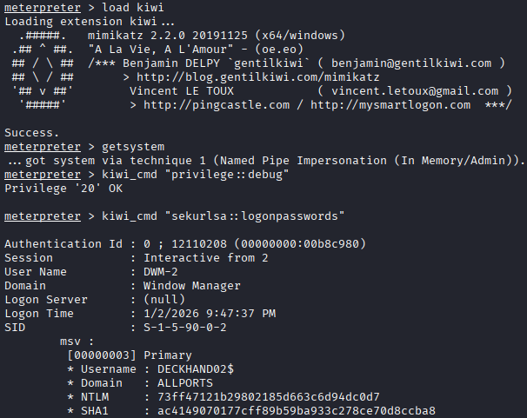
Stolen Credentials
Places to look:
C:\Users\USER\.ssh - ssh keys
User Desktop/Documents files
history
  Passwords typed into the terminal
Tools to automatically search for credentials
  Mimikatz - Extract from memory
  LaZagne - Plaintext, Databases, Browsers
Office hours to learn more about these tools!

Slide 13
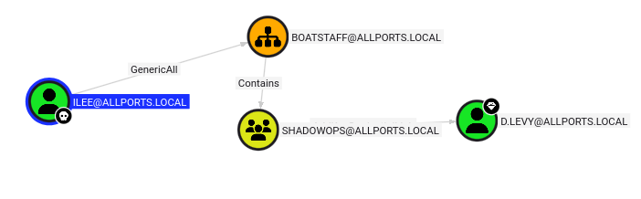
Poor Access Control Lists
Used for lateral movement
  Move from user to another user or group
Bloodhound
  Utilizes graph theory to find shortest ACL abuse chain to Administrator
  Graph all connections in an Active Directory network
  Contains users, groups, and all permissions
Note this will not be seen in Netseige
Notes:
Bloodhound may not be accurate, due to not having permissions to read all the ACLs, or if firewalls block.

Slide 14
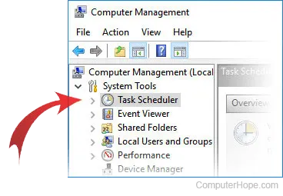
Scheduled Tasks
Tasks that are scheduled to run automatically
Usually run at high privilege/system level access for backup or auditing purposes
Can be abused if writeable by lower privileged users
  Note: In a real engagement ask for permission before changing scheduled tasks
Can be found in user files or Computer Management > Task Scheduler

Slide 15
Windows Priv Esc Hardening
Check and remove any files containing credentials
  Change potentially leaked credentials
  Rotate potentially stolen ssh keys
Use CredsGuard to protect credentials on the system
Use Antivirus to block malicious scripts from stealing credentials
Audit Access Control Lists and follow Principle of Least Privilege
Ensure Scheduled Tasks are only editable as high privileged user
Notes:
CredsGuards protects hashes from being accessed by unauthorized users or services.

Slide 16
Key Ideas
1
Lateral vs Horizontal Priv Esc
2
Stolen/Leaked Creds
3
Linux Binary Exploitation
4
Scheduled Tasks
5
Broken ACLS

Slide 17
Extra Credit
1
Dumping secrets via Mimikatz
Office hours:
Dhruv: 4:00 - 5:00 PM on Monday
Sterling: 2:00 - 3:00 PM on Friday
Drew: 12:30 - 1:30 PM on Thursday
2
Using LaZange
3
WinPEAS/LinPEAS
4
PSPY
5
Questions and Support

